Slide 1
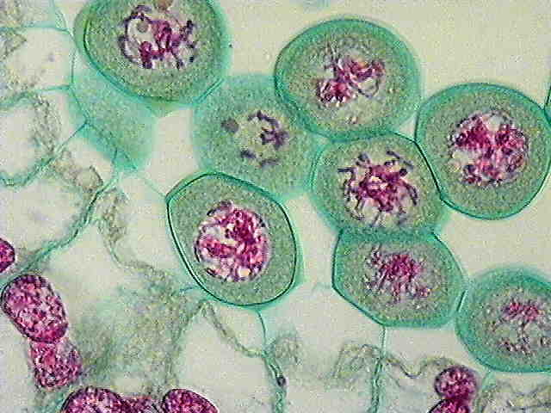
Nuclear Envelope
Cell
Membrane
Chromosomes
© International Association of Sexual Plant Reproduction Research (IASPRR) – see http://www.iasprr.org/

Slide 2
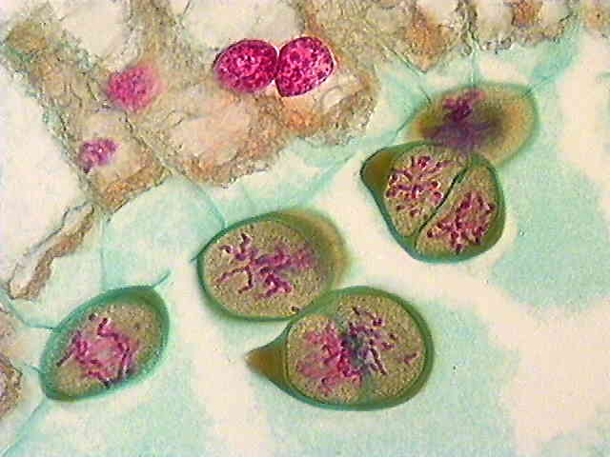
Cell Membrane
Chromosomes
© International Association of Sexual Plant Reproduction Research (IASPRR) – see http://www.iasprr.org/

Slide 3
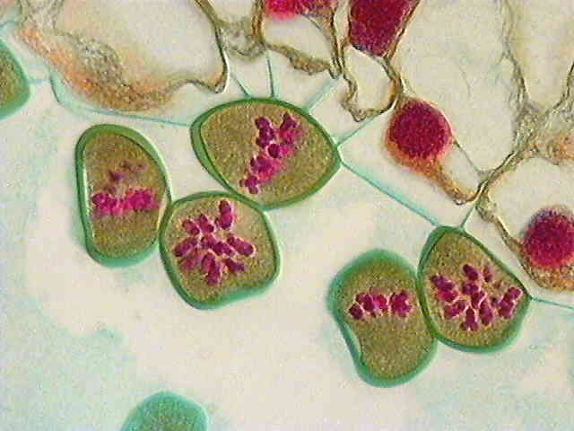
Cell Membrane
Chromosomes
Cell Membrane
Chromosomes
Chromosomes
© International Association of Sexual Plant Reproduction Research (IASPRR) – see http://www.iasprr.org/

Slide 4
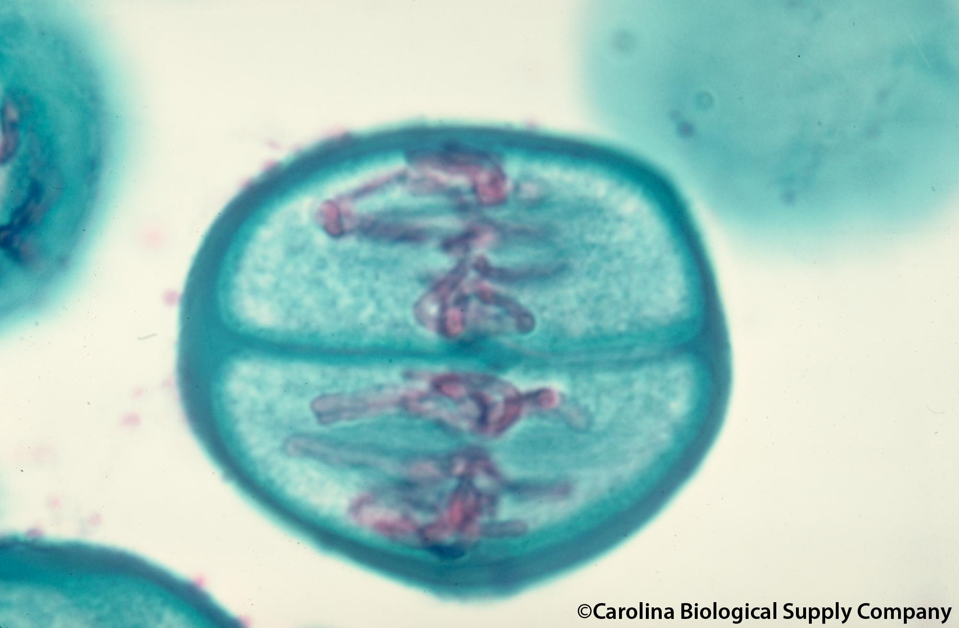
Chromosomes
Cell
Membrane

Slide 5
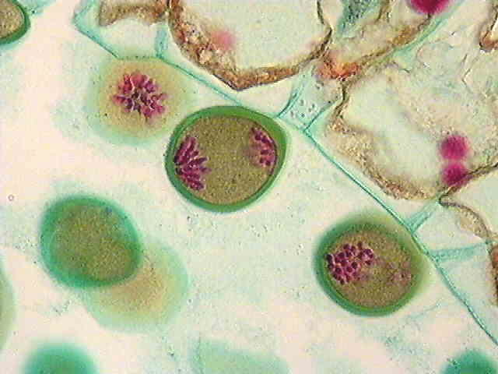
Chromosomes
Cell Membrane
© International Association of Sexual Plant Reproduction Research (IASPRR) – see http://www.iasprr.org/

Slide 6
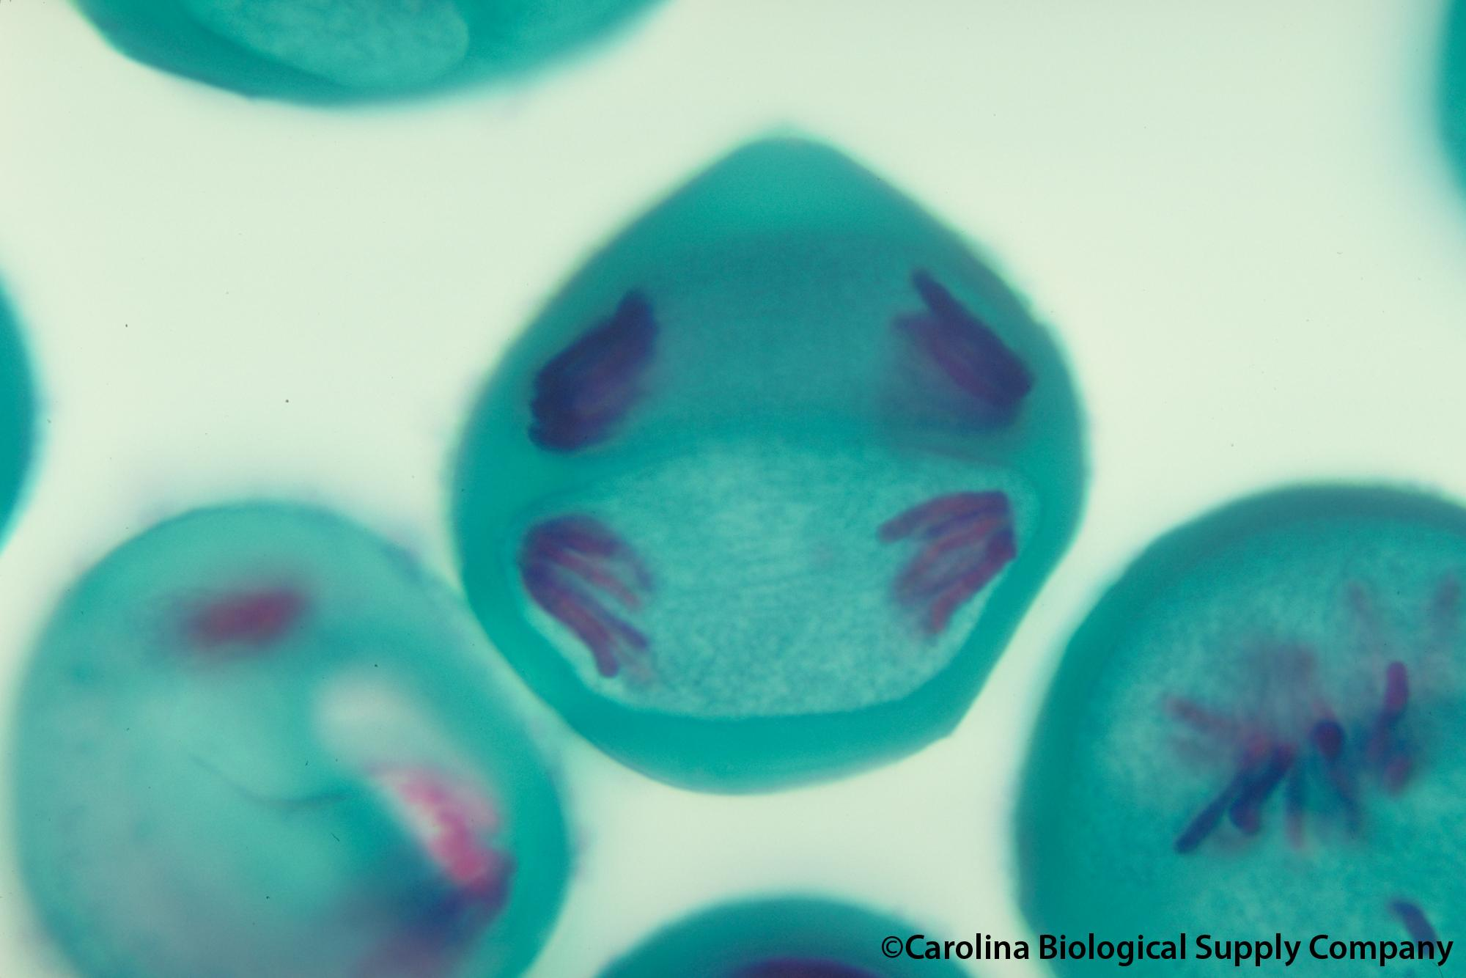
Cell Membrane
Chromosomes

Slide 7
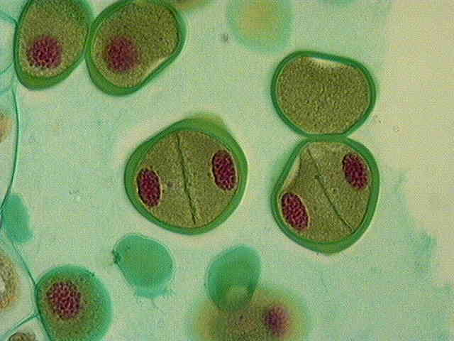
Cell Membrane
A cell before it goes through meiosis
Chromosomes
© International Association of Sexual Plant Reproduction Research (IASPRR) – see http://www.iasprr.org/

Slide 8
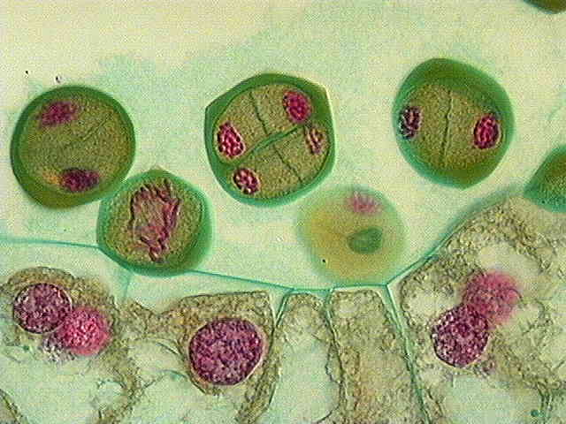
Chromosomes
Chromosomes
Chromosomes
Cell Membrane
Cell Membrane
Chromosomes
© International Association of Sexual Plant Reproduction Research (IASPRR) – see http://www.iasprr.org/

