Slide 1
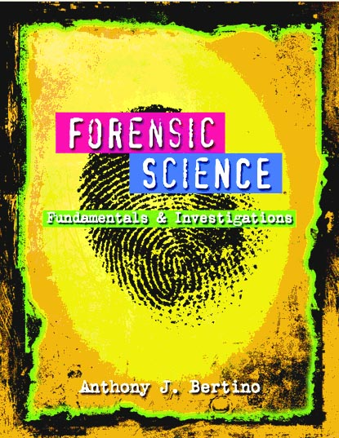
Chapter 10 Handwriting Analysis, Forgery, and Counterfeiting By the end of this chapter you will be able to:
Describe 12 types of handwriting characteristics
that can be analyzed in a document
Demonstrate an example of each of the 3 types of handwriting traits
Identify the major goal of a forensic handwriting analysis
All Rights Reserved South-Western / Cengage Learning © 2012, 2009

Slide 2
Chapter 10 Handwriting Analysis, Forgery, and Counterfeiting By the end of this chapter you will be able to:
Distinguish between the terms forgery and fraudulence
Identify several ways that businesses prevent check forgery
Describe 4 features of paper currency that are used to detect counterfeit bills

Slide 3
Introduction
Examine and compare questioned documents with known material
Field investigations include:
Handwriting
Computer printouts
Commercial printing
Paper and ink
Threatening, ransom, or suicide notes
Analysis helps identify a document’s author

Slide 4
History of Forensic Handwriting Analysis
1930s—handwriting analysis played a role in the famous Lindbergh case.
1999—the US Court of Appeals determined that handwriting analysis qualifies as a form of expert testimony
To be admissible in court, scientifically accepted guidelines must be followed
Scotland Yard, the FBI, and the Secret Service use handwriting analysis

Slide 5
Introduction to Handwriting
Everyone’s handwriting shows natural variations. Here are 6 of the 12 major, specific traits.

Slide 6
Introduction to Handwriting
The traits are functions of formatting or of letter or line form. Here are the other 6 of the 12 major, specific traits.

Slide 7
Handwriting Examination
Two writings came from one person if:
their similarities are unique and
no unexplainable difference(s) are found
Examine the questionable document for detectable traits and record them
Obtain a known sample of the suspect’s writing (an exemplar)
Compare and draw conclusions about the authorship of the questionable document

Slide 8
Technology Used in Handwriting Analysis
Biometric Signature Pads
“Learns” to recognize how a person signs
Evaluates speed, pressure, and rhythm of the signature
Recognizes forgeries by the detection of even slight differences
Computerized Analysis
Compares handwriting samples objectively
Compared with samples stored in databases

Slide 9
Handwriting
Evidence in the Courtroom
Expert explains how comparisons were made
Cross-examination by defense attorney may follow
Shortcomings in Analysis
Are the base documents real or fake?
Did mood, age, fatigue impact the handwriting?
Did experts miss details any details?

Slide 10
Forgery
Forged documents include:
checks
employment records
legal agreements
licenses
wills
Fraudulence—forgery for material gain

Slide 11
Forgery
Check forgery can include:
ordering another’s checks from a deposit slip
altering a check
intercepting another’s check, altering, and cashing it
creating a check from scratch

Slide 12
Preventing Check Forgery
Chemically sensitive paper
Large font size requires more ink and makes alterations more difficult
High resolution borders that are difficult to copy
Multiple color patterns
Embed fibers that glow under different light
Use chemical wash detection systems that change color when a check is altered

Slide 13
Literary Forgery
Best forgeries aim to duplicate the materials found in the original:
old paper
chemically treated materials to fake an older look
inks mixed from substances that would have been used at the time
watermarks that add the appearance of age
tools and styles that would have been popular at the time

Slide 14
Counterfeiting
A criminal activity existing since antiquity
Items commonly forged today include:
Currency
Traveler’s checks
Food stamps
Certain bonds
Postage stamps

Slide 15
Counterfeit Currency
Security features are added to paper currency that scanning cannot reproduce
Regular printer paper contains starch.
Paper currency contains rag fiber instead of starch.

Slide 16
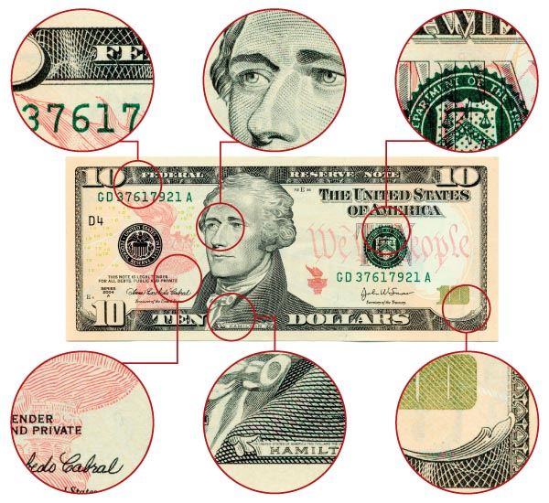
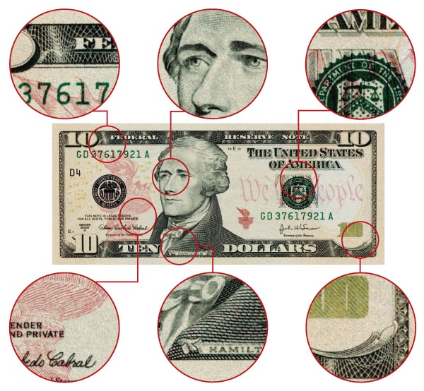
Counterfeit vs. Authentic

Slide 17
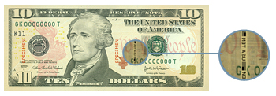
Verifying Authentic Currency
New security features:
Portrait stands out and appears raised off the paper
Contains clear red and blue fibers woven throughout the bill
Has clear, distinct border edges
Treasury seal is shown with clear, sharp saw-tooth points
Watermark appears on the right side of the bill in the light

Slide 18
Verifying Authentic Currency
New security features:
The security thread is evident—a thin embedded vertical strip with the denomination of the bill printed in it
There is minute printing on the security threads, as well as around the portrait
When the bill is tilted, the number in the lower right-hand corner makes a color shift from copper to green

Slide 19
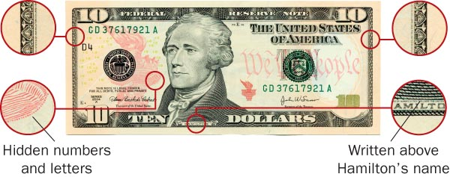
Examples of Security Features

Slide 20
. . . . . . . . . . . . . . . . . Summary
Handwriting analysis compares questioned documents with exemplars to establish authorship.
Aspects of a person’s handwriting style can be analyzed to ascertain authenticity.
Many new features of paper currency help prevent counterfeiting.
Technological advances have enhanced chances of detecting forged documents.

