Slide 1
Chapter 8 Blood and Blood Splatter By the end of this chapter you will be able to:
Explain the composition of blood
Describe the function of blood cells
Determine the blood type of a blood sample
Conduct a blood splatter analysis
Examine wounds and describe the nature of the weapon
Find and process blood evidence
All Rights Reserved South-Western / Cengage Learning © 2012, 2009

Slide 2
Introduction and History
Blood typing provides class evidence
DNA profiling provides individual evidence
A blood splatter pattern provides information
the truthfulness of an account by a witness or a suspect
the origin of the blood
the angle and velocity of impact
the type of weapon used

Slide 3
Composition of Blood
Plasma—a liquid suspending other blood components
Red blood cells (Erthrocytes)—carries oxygen to the body’s cells and carbon dioxide away
White blood cells (Leukocytes)—fights disease and foreign invaders and, alone, contain cell nuclei
Platelets—aids in blood clotting and the repair of damaged blood vessels

Slide 4
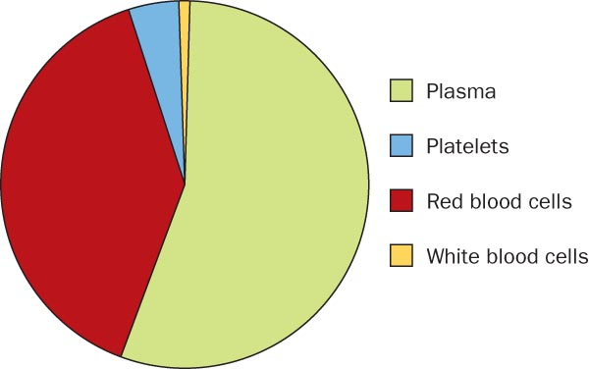
Composition of Blood

Slide 5
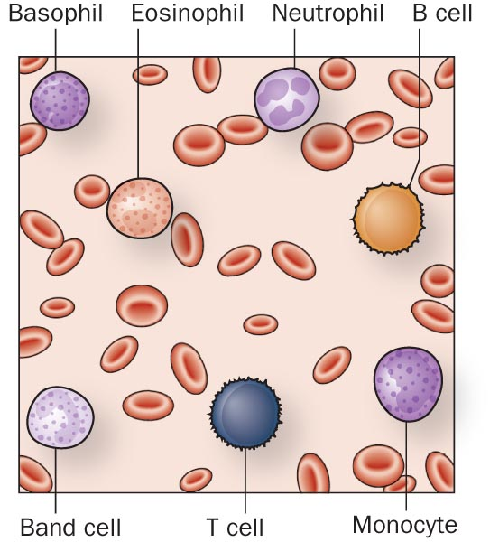
Types of Blood Cells

Slide 6
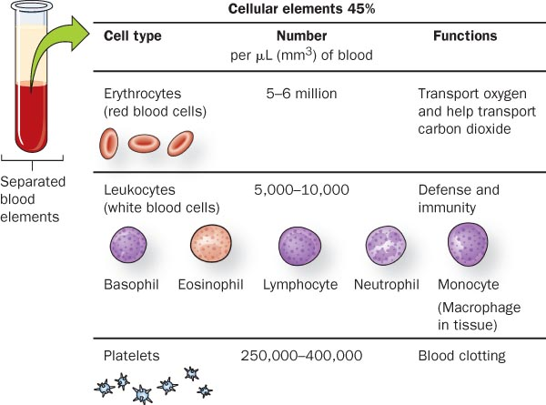
Cellular Components of Blood

Slide 7
Blood Typing—Proteins
Discovered in 1900 by Karl Landsteiner
Identifies the presence or absence of particular proteins embedded in the cell
Quicker and less expensive than DNA profiling
Produces class evidence but can still link a suspect to a crime scene or exclude a suspect

Slide 8
Blood Typing—Proteins
42% 12% 3% 43%
of the population in the United States

Slide 9
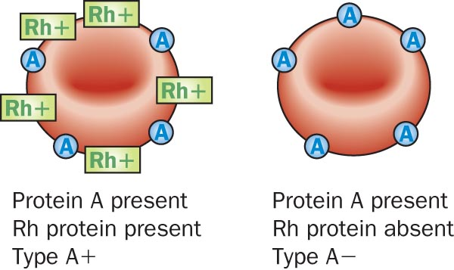
Rh Factor
85% of the population has a protein called RH factor on their blood cells

Slide 10
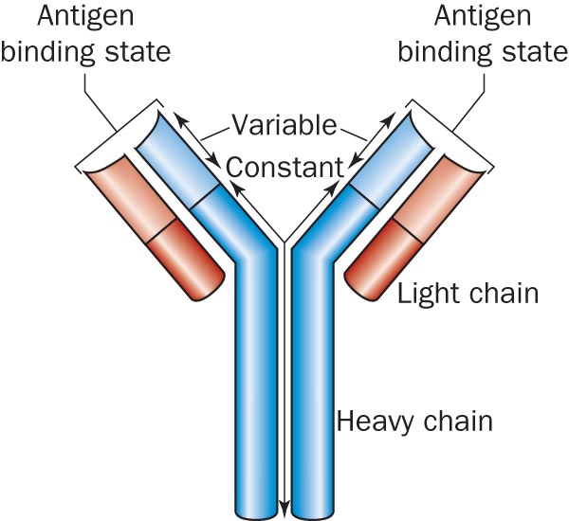
Blood Typing—Antibodies
Antibodies are Y-shaped proteins secreted by white blood cells that attach to antigens to destroy them
Antigens are foreign molecules or cells that react to antibodies

Slide 11
Blood Enzymes
Enzymes are complex proteins that catalyze different biochemical reactions
Many enzymes and proteins have been found in the blood that are important for identification purposes

Slide 12
Blood Typing —Probability and Blood Types
The probability of a blood type equals the product of probabilities for each protein group
If Type A = 42% and Rh Factor = 85%
Then A+ = .42 x .85 = .357 (35.7%)
Knowing additional proteins and enzymes in the blood sample
Narrows the population group
Increases the probability of identifying a suspect

Slide 13
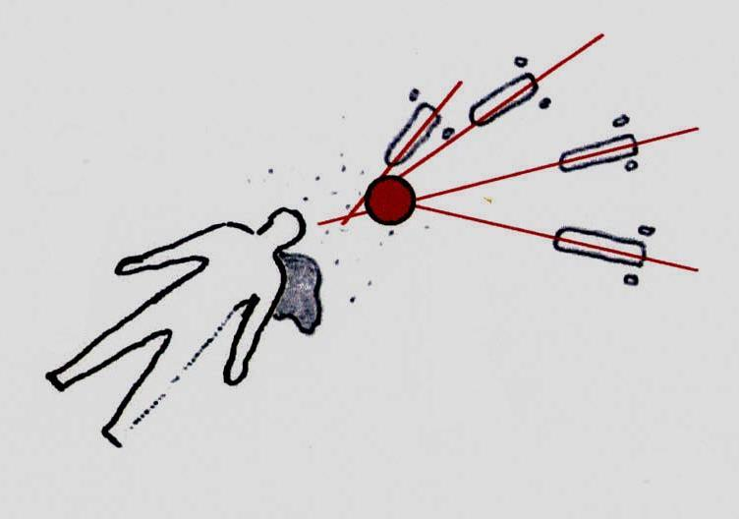
Blood Splatter
1939—splatter patterns first analyzed
Blood may splatter when a wound is inflicted
Blood splatter pattern—a grouping of blood stains
Patterns help to reconstruct the events surrounding a shooting, stabbing, or beating

Slide 14
Blood Splatter Analysis
Analysis of a splatter pattern can aid in determining the:
direction blood traveled
angle of impact
point of origin of the blood
velocity of the blood
manner of death

Slide 15
Blood Splatter Analysis
Natural cohesiveness of blood

Slide 16
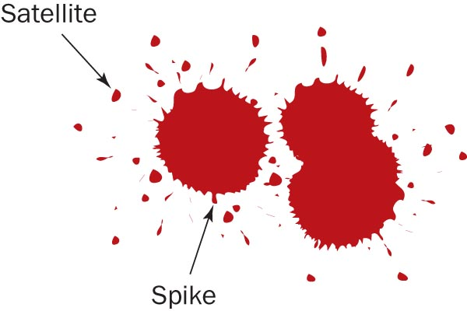
Blood Splatter Analysis
Satellite droplets—
When blood falls from a height, or at a high velocity,
It overcomes its natural cohesiveness, and
Separates from the main droplet
Spiking patterns—
Form around the droplet edges when blood falls onto a less-than-smooth surface

Slide 17
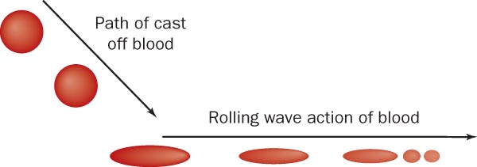
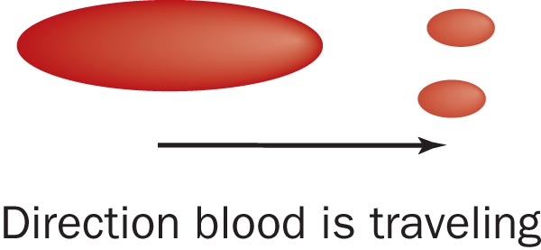
Blood Splatter Analysis —Directionality
The shape of an individual drop of blood provides clues to the direction from where the blood originated.
How will the point of impact compare with the rest of a blood pattern?

Slide 18
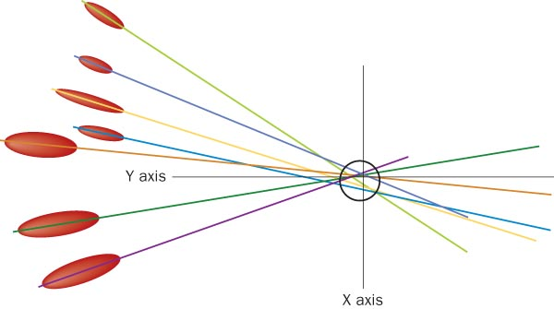
Blood Splatter Analysis
Lines of convergence—two or blood splatters can pinpoint the location of the blood source

Slide 19
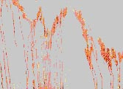
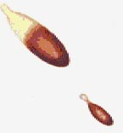
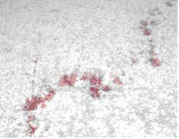
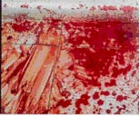
Blood Splatter Analysis —Six Patterns
Describe each of these:
Passive drops
Arterial gushes
Splashes
Smears
Trails
Pools

Slide 20
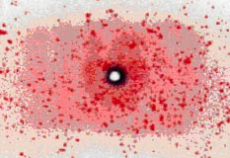
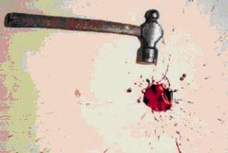
Blood Splatter Analysis —Impact
Patterns can help investigators determine the type of weapon used
What kind of a pattern is produced by a gun shot?
What kind of a pattern is produced by a hammer blow?

Slide 21
Crime Scene Investigation of Blood
Search for blood evidence
Determine
Is the evidence blood?
Is the blood human?
What is the blood type?
Interpret the findings:
Does the blood type match a suspect’s blood?
If not, exclude that suspect
If yes, decide if DNA profiling is necessary

Slide 22
. . . . . . . . . . . . . . . . . Summary
Blood consists of cellular components and plasma.
The various human blood types are caused by the presence or absence of A and/or B proteins on the surface of red blood cells.
Blood splatter evidence can be used to recreate a crime scene.
Investigators endeavor to (a) locate, (b) identify, and (c) interpret blood splatter patterns at crime scenes.

