Slide 1
Chapter 6 Fingerprints By the end of this chapter you will be able to:
Discuss the history of fingerprinting
Describe the characteristics of fingerprints and fingerprinting minutiae
Explain when and how fingerprints form
Describe how fingerprints can be left on objects
Identify the basic types of fingerprints
Describe how criminals attempt to alter their fingerprints
All Rights Reserved South-Western / Cengage Learning © 2012, 2009

Slide 2
Chapter 6 Fingerprints By the end of this chapter you will be able to:
Determine the reliability of fingerprints as a means of identification
Describe the Integrated Automated Fingerprint Identification System (IFAIS)
Explain how fingerprint evidence is collected
Describe the latest identification technologies
Determine if a fingerprint matches a fingerprint on record
Use the process of lifting a latent print

Slide 3
Historical Development
3rd century B.C. in China—oldest known documents
Ancient Babylon (1792-1750 B.C.)—fingerprints pressed into clay tablets marked contracts
1684—Dr. Nehemiah’s paper describes the patterns on human hands, including the presence of ridges
1788—Johann Mayer noted that the arrangement of skin ridges is never duplicated in two persons

Slide 4
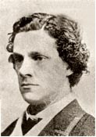
Historical Development
1823—Jan Evangelist Purkyn describes nine fingerprint patterns
1856—Sir William Herschel (right) began the collection of fingerprints and noted they were not altered by age
1883—Alphonse Bertillon created a way to identify criminals that were repeat offenders

Slide 5
Historical Development
1888—Sir Francis Galton (r) and Sir Edmund Richard Henry developed the fingerprint classification system still used in the US
1891—Iván (Juan) Vucetich collected all ten fingerprint impressions and noted measurements
1896—Sir Henry, with two colleagues, created a system that divided fingerprints into groups. All ten fingerprints are imprinted on a card (called a ten card) along with other notations

Slide 6
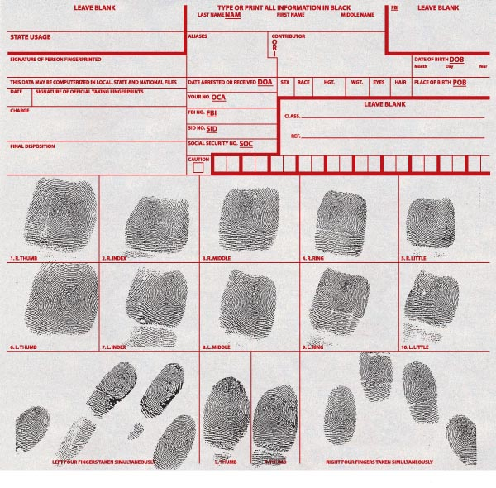
Example of a Ten Card

Slide 7
What Are Fingerprints?
All fingers, toes, feet, and palms are covered in small ridges
Ridges help us grip objects
Ridges are arranged in connected units called dermal, or friction, ridges
Fingers accumulate natural secretions and dirt
Fingers leave create prints on objects we touch

Slide 8
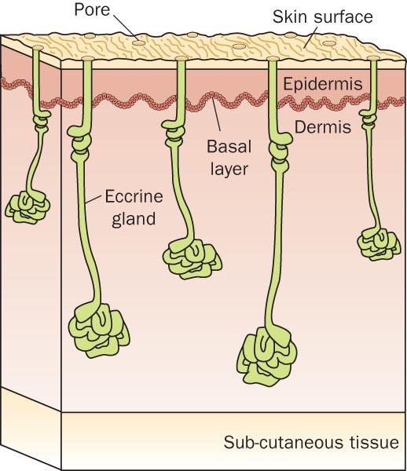
Structure of Skin

Slide 9
Formation of Fingerprints
Skin consists of:
Inner layer—dermis
Outer layer—epidermis
Basal layer in between
Basal layer grows faster than the layers above and below it
Basal layer collapses and folds to form intricate shapes
Fingerprints begin forming near the 10th week of pregnancy

Slide 10
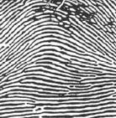
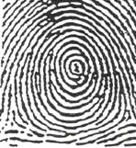
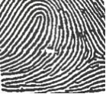
Characteristics of Fingerprints
There are 3 general fingerprint distinctions:
ARCH About 5% | WHORL About 30% | LOOP About 65%
 | of the population

Slide 11
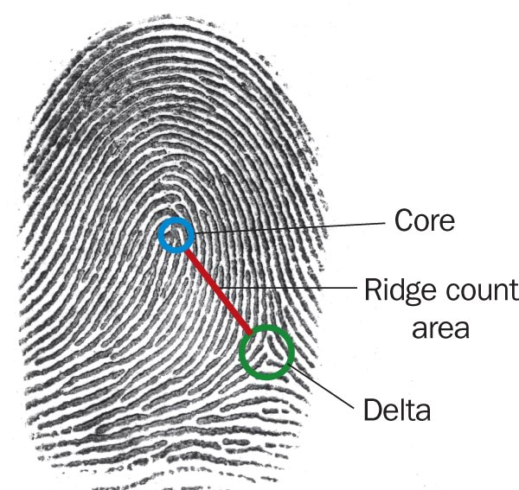
Characteristics of Fingerprints
Forensic examiners look for
Core (the center of a whorl or loop)
Deltas (triangular regions near a loop)
Ridge count
Counting from the core to the edge of the delta
Distinguishes one fingerprint from another

Slide 12
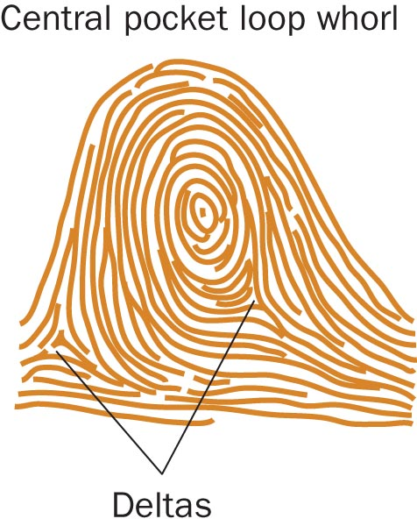
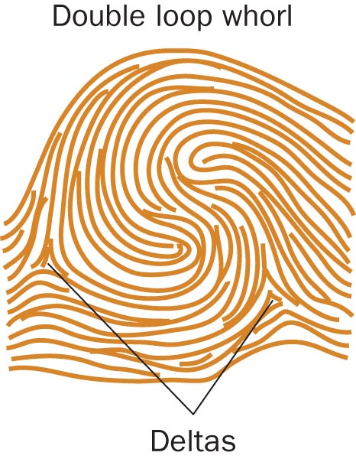
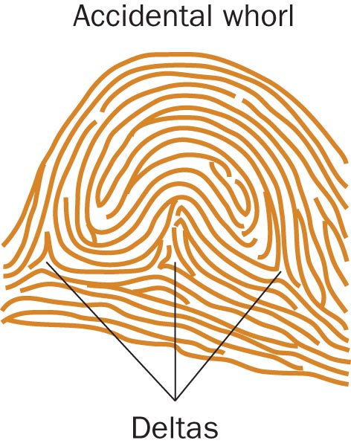
Characteristics of Fingerprints

Slide 13
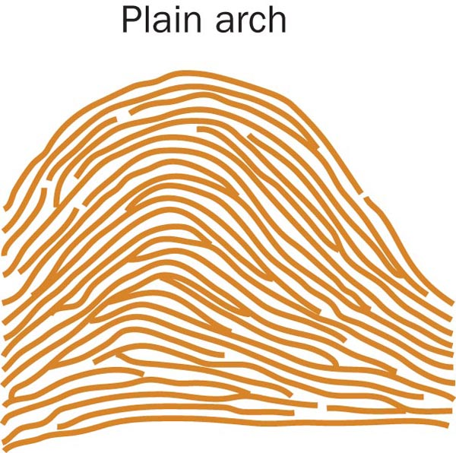
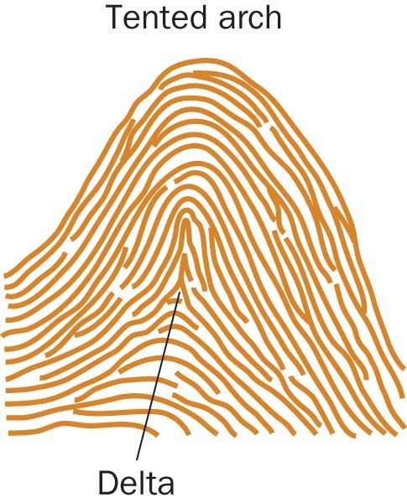
Characteristics of Fingerprints

Slide 14
Characteristics of Fingerprints
Basic patterns can be further divided:
Arch patterns:
4% plain
1% tented
Whorl patterns:
2% central pocket
4% double loop
0.01% accidental
Even twins have unique fingerprints

Slide 15
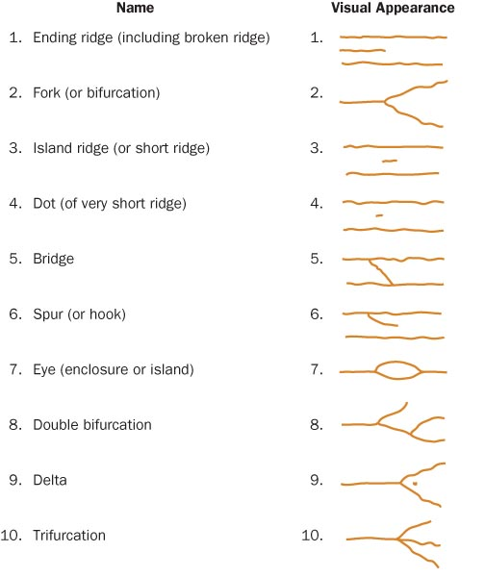
Fingerprint Minutiae Patterns

Slide 16
Types of Fingerprints
There are 3 types of prints that investigators look for at crime scenes:
Patent fingerprints—visible prints transferred onto smooth surfaces by blood or other liquids
Plastic fingerprints—indentations left in soft materials such as clay or wax
Latent fingerprints—made visible by dusting with powders or the use of chemicals

Slide 17
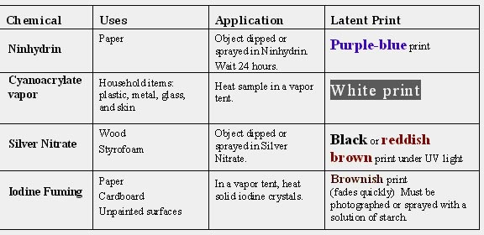
Fingerprint Forensic FAQs
How are latent fingerprints collected?

Slide 18
Fingerprint Forensic FAQs
Can fingerprints be erased?
Only temporarily; they will grow back if removed with chemicals
Is fingerprint identification reliable?
Yes, but analysts can make mistakes
Can computers perform matches in seconds?
No, but the FBI’s Integrated Automated Fingerprint Identification System (IAFIS or AFIS) can provide a match in 2 hours

Slide 19
The Future of Fingerprinting
New scanning technologies
Yield detail in minute patterns
Reduce analytical mistakes
Analyze trace elements of objects on the skin
Technologies that recognize patterns in
Retina
Face
Veins in your palm

Slide 20
. . . . . . . . . . . . . . Summary . . . .
Fingerprints have long been used for identification, and in the mid-1800s were recognized as unique to each person.
Three main groups include arches, whorls, and loops.
Basic analysis includes looking for cores and deltas and making a ridge count.

Slide 21
. . . . . . . . . . . . . . . . . Summary
Investigators search for patent, plastic, and latent prints.
Dusting with powders or using special chemicals can make latent fingerprints visible.
New developments may eliminate errors by analysts.

