Slide 1
Chapter 3 The Study of Hair By the end of this chapter you will be able to:
Identify the various parts of a hair
Describe variations in the structure of the medulla, cortex, and cuticle
Distinguish between human and nonhuman hair
All Rights Reserved South-Western / Cengage Learning © 2012, 2009

Slide 2
Chapter 3 The Study of Hair By the end of this chapter you will be able to:
Determine if two examples of hair are from the same person
Explain how hair can be used in a forensic investigation
Calculate the medullary index for a hair

Slide 3
History of Hair Analysis
1883: Alfred Swaine Taylor and Thomas Stevenson covered hair in a forensic science text
1910: Victor Balthazard and Marcelle Lambert published a comprehensive study of hair
1934: Dr. Sydney Smith, analyzed hairs side by side
Today: chemical tests, neutron activation analysis, and DNA analysis

Slide 4
The Function of Hair
Regulates body temperature
Decreases friction
Protects against sunlight

Slide 5
The Structure of Hair
A follicle embedded in the skin produces the hair shaft
Three layers (illustrated above):
the inner medulla
the cortex
the outer cuticle

Slide 6
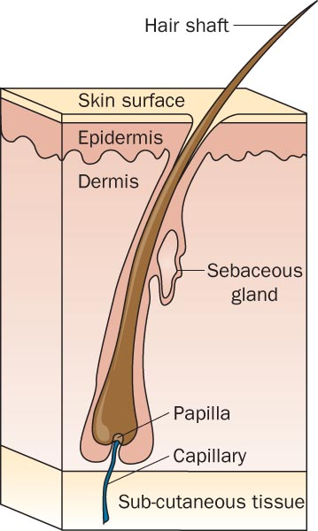
The Structure of Hair

Slide 7
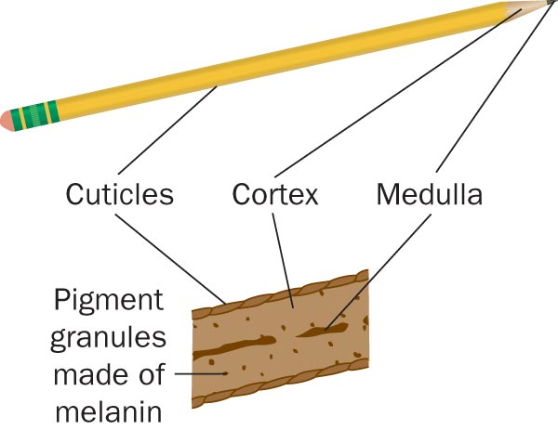
Cuticles, Cortex, and Medulla

Slide 8
Types of Cuticle and Cortex
Cuticle:
the outermost layer
over-lapping scales that protect the inner layers
Cortex:
Thickest layer
Contains most of the pigment
Distribution of pigment varies
Usually denser nearer the cuticle

Slide 9
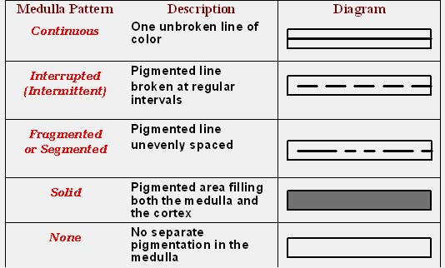
Types of Medulla

Slide 10
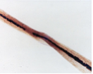
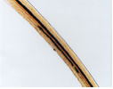
Types of Hair
Buckled Blunt Double Medulla
A cross section: circular, triangular, irregular, or flattened
Shape: influences the curl of the hair
Texture: coarse or fine

Slide 11
Types of Hair
Human hair varies on the body
Head
Eyebrows
Lashes
Mustache
Beard
Underarms
Body hair
Pubic

Slide 12
The Life Cycle of Hair
Hair proceeds through 3 stages as it develops:
Anagen stage:
hair actively grows
cells around the follicle rapidly divide and deposit materials in the hair
Catagen stage:
hair grows and changes
Telogen stage:
follicle becomes dormant

Slide 13
Treated Hair
Bleaching
disturbs the scales on the cuticle and
removes pigment
leaves hair brittle and yellowish
Dyeing colors the cuticle and the cortex

Slide 14
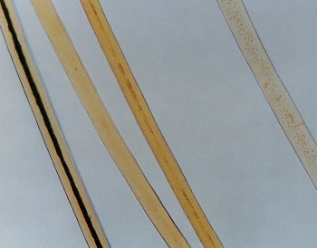
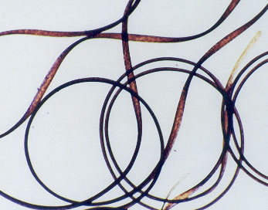
Racial Differences
Broad, racial groups do exhibit some shared physical characteristics
But NOT applicable to all individuals in these groups
Therefore,
Individual hairs CANNOT be assigned to any of these groups

Slide 15
Animal Hair and Human Hair
Pigmentation:
animal hair is denser toward the medulla
human hair tends to be denser toward the cuticle
Banded Color Patterns:
possible in animals
not in humans
Medulla: much thicker in animals

Slide 16
Medulla Index— Animals vs. Humans

Slide 17
Animal Hair and Human Hair
Spinous Coronal Imbricate
Animals: cuticle scales resemble petals (spinous) or a stack of crowns (coronal)
Humans: commonly flattened and narrow (imbricate)

Slide 18
Using Hair in an Investigation
Macroscopic investigations indicate
length
color
curliness
Phase contrast microscopy shows
presence of dye or other treatments
Electron microscopes yield yet more detail

Slide 19
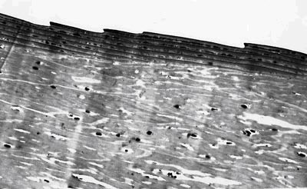
Using Hair in an Investigation
Note the overlapping scales and the pigment granules in the cortex

Slide 20
Testing for Substances in the Hair Shaft
Chemical tests
presence of various substances
Examining a hair shaft
timeline for exposure to toxins
Neutron Activation Analysis (NAA)
concentrations of substances

Slide 21
Testing the Hair Follicle
Microscopic assessment
Cost effective and quick
Blood test
Determine blood type
DNA analysis
Identification with a high degree of confidence

Slide 22
Microscopic Assessment
Preparation

Slide 23
. . . . . . . . . . . . . . Summary . . . .
Hair functions to regulate temperature, reduce friction, protect from light, and produce sensory data.
Hair consists of a (a) hair shaft produced by a (b) follicle embedded in the skin.
The shaft consists of an outer cuticle, a cortex, and an inner medulla.
Hair characteristics vary depending on location on the body.

Slide 24
. . . . . . . . . . . . . . . . . . Summary
Hair development has three stages: anagen, catagen, and telogen.
Various hair treatments produce characteristic effects useful to forensic experts.
Some characteristics can be grouped into general racial categories.
Forensic experts examine hair using chemicals, light, electrons, neutrons, and DNA sequencing.

