Slide 1
Chapter 2 Crime Scene Investigation and Evidence Collection By the end of this chapter you will be able to:
Summarize Locard’s exchange principle
Identify four examples of trace evidence
Distinguish between direct and circumstantial evidence
Identify the type of professionals who are present at a crime scene
Describe how evidence from a crime scene is analyzed
All Rights Reserved South-Western / Cengage Learning © 2012, 2009

Slide 2
Chapter 2 Crime Scene Investigation and Evidence Collection By the end of this chapter you will be able to:
Summarize the three steps of a crime scene investigation
Explain the importance of securing the crime scene
Identify the methods by which a crime scene is documented
Demonstrate proper technique in collecting and packaging trace evidence

Slide 3
Principle of Exchange
Established by Dr. Edmond Locard, the principle states:
When a person comes in contact with an object or another person, a cross-transfer of physical material can occur
Study of the material can determine the nature and duration of the transfer

Slide 4
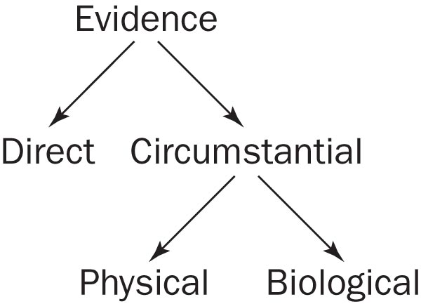
Types of Evidence
Direct evidence
Testimony by a witness about what that witness saw, heard, or did

Slide 5
Types of Evidence
Circumstantial evidence
also called Indirect
trace evidence
Physical evidence
e.g., fingerprints
Biological evidence
e.g., blood or hairs

Slide 6
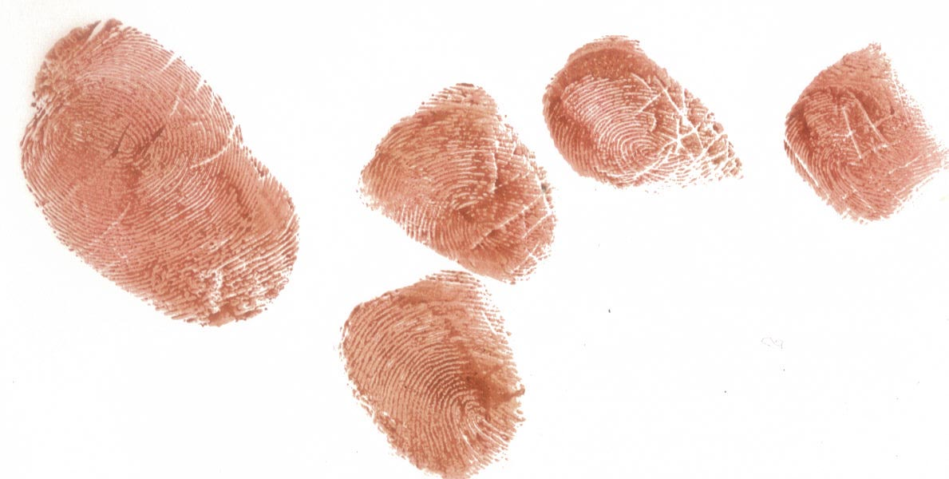
Types of Evidence
Explain why this would be or
would not be trace evidence

Slide 7
The Crime Scene Investigation Team
Who is at the crime scene?
Police and
District attorney (possibly)
Crime scene investigators
Medical examiners
Detectives
Specialists

Slide 8
The Seven S’s of Crime Scene Investigation
Secure the scene
Separate the witnesses
Scan the scene
Seeing the scene
Sketch the scene
Search for evidence
Secure the collected evidence

Slide 9
Crime-Scene Sketch Form

Slide 10
Crime-Scene Search Patterns

Slide 11
Packaging the evidence
Crease a clean paper and place evidence in the X position
Fold in the left and right sides, and then fold in the top and bottom
Put the bindle into a plastic or paper evidence bag affixing a seal over the opening
Write your name on the seal

Slide 12
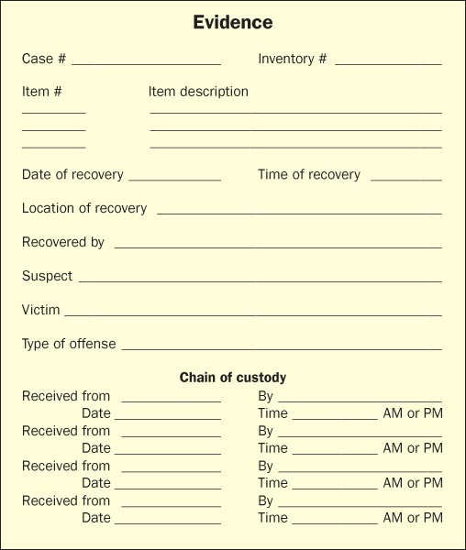
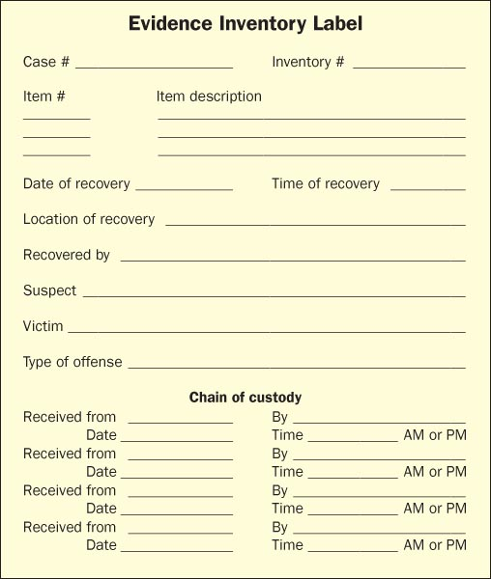
Evidence ID Forms

Slide 13
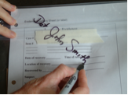
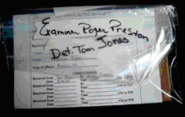
Chain of Custody
Maintaining a chain of custody log is essential to present credible evidence in court

Slide 14
Chain of Custody (cont’d.)
Bag the evidence Add identification Seal it Sign it across the sealed edge
Sign over to a lab technician Open bag on non-sealed edge
Return items to the evidence bag Seal evidence bag in another bag Sign the evidence log

Slide 15
Analyze the Evidence
Facts result from collected evidence processed by the forensic lab
Lead detective aims to see how facts fit into the crime scenario

Slide 16
Analyze the Evidence
Lab results can:
Show reliability of witness accounts
Establish the identity of suspects or victims
Show suspects to be innocent or link them with a scene or victim

Slide 17
Crime Scene Reconstruction
Crime scene reconstruction involves:
Forming a hypothesis of the sequence of events
From before the crime was committed through its commission

Slide 18
Staged Crime Scenes
When lab results don’t match up with the testimony of witnesses
Common examples:
Staging a fire—to cover bankruptcy
Staging a suicide—to cover a murder
Staging a burglary—to collect insurance money

Slide 19
Staged Crime Scenes
Was the crime scene staged? Consider:
Does the type of wound match the weapon?
Could the wound be easily self-inflicted?
What were the mood and actions of the victim before the event?
What were the mood and actions of the suspect before the event?

Slide 20
. . . . . . . . . . . . . . Summary . . . .
Locard’s exchange principle:
Contact between people and objects can transfer material that can determine the nature and duration of the transfer
Evidence can be direct or indirect
Physical or biological traces
A crime scene investigation team consists of police, detectives, crime scene investigators, medical investigators, and specialists.

Slide 21
. . . . . . . . . . . . . . . . . Summary
Investigations consist of recognizing, documenting, and collecting evidence.
First responding officers identify the extent of the crime scene, secure it, and segregate witnesses.
Crime scene investigators document the crime scene.
Evidence is collected, packaged, and labeled.
The evidence is analyzed and interpreted to fit the crime scenario.

