Slide 1
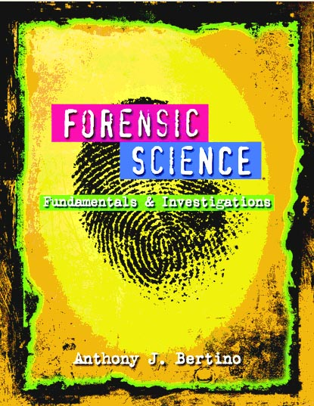
x
All rights Reserved
South-Western / Cengage
Learning © 2012, 2009

Slide 2
Chapter 1 Observation Skills By the end of this chapter you will be able to:
Define observation and describe what changes occur in the brain
Describe examples of factors influencing eyewitness accounts of events
Compare the reliability of eyewitness testimony with what actually happened

Slide 3
Chapter 1 Observation Skills By the end of this chapter you will be able to:
Relate observation skills to their use in forensic science
Define forensic science
Practice and improve your observation skills

Slide 4
Introduction
The forensic examiner must be able to
find—identify the evidence
document—record the evidence
interpret—accurately determine the significance of the evidence

Slide 5
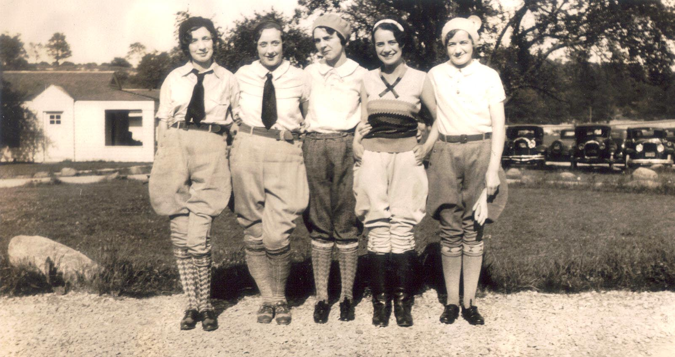
What Is Observation?
Our brains can filter out information.
Point out some of the details in this photo.

Slide 6
What Is Observation?
How information is processed in the brain

Slide 7
What Is Observation?
Our brains fill in gaps in our perception
In order to make sense of what we perceive, our brains often enrich with detail what we see, taste, hear, smell, or feel
After an event, we can believe things were part of the background even though they were not

Slide 8
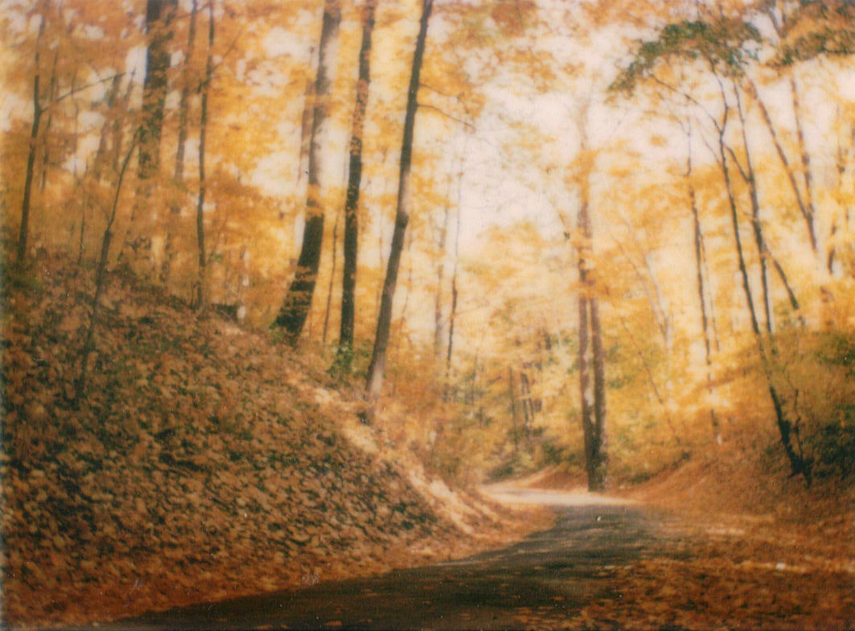
What Is Observation?
Our brains apply previous knowledge to new situations
What assumptions can you make about this scene?
How might those assumptions be wrong?

Slide 9
Observations by Witnesses
Observations are affected by:
Their emotional states
Whether they were alone, part of a group, or near others
What type of and how much activity was going on around them

Slide 10
Eyewitness Accounts
Crime-scene reports often vary, due to:
level of interest
stress
concentration
amount and kind of distractions present
prejudices
personal beliefs
motives
any lapse in time since the event

Slide 11
The Innocence Project
Barry C. Scheck and Peter J. Neufeld Benjamin N. Cardozo School of Law,
Beginning in 1992, used DNA to examine post-conviction cases
Faulty eyewitness identifications accounted for up to 87% of the wrongful convictions

Slide 12
How to be a Good Observer
Observe systematically
Start at one part of a crime scene and run your eyes slowly over every space
Look carefully at details of each piece of evidence
Do not assume you will remember everything

Slide 13
How to be a Good Observer
Turn off filters
Consciously pay attention to all details
Do not pay attention to just what you think is important
All details are potentially important

Slide 14
How to be a Good Observer
Collect Information first, interpret data later
Look for patterns and make connections
More information yields better interpretations
Prejudices exist everywhere—
eyewitness accounts
your own thinking processes

Slide 15
How to be a Good Observer
Documentation, Documentation, Documentation
Write down and photograph as much information as possible
Be aware that memory is faulty
Remember that our brains tend to fill in gaps in our perceptions

Slide 16
Observations in Forensics
Study situations
Find clues in ordinary details
Work backwards from the evidence to what led up to the crime
Be patient
Practice

Slide 17
. . . . . . . . . . . . . . Summary . . . .
The environment and our natural sensory filters affect our ability to observe
Eyewitness reports can be correct, faulty, or a little of both
Acquiring good observation skills takes practice and training

Slide 18
. . . . . . . . . . . . . . . . . . Summary
Forensic scientists:
Find and Document Evidence
Evaluate and Interpret
Provide expert testimony to courts

