Slide 1
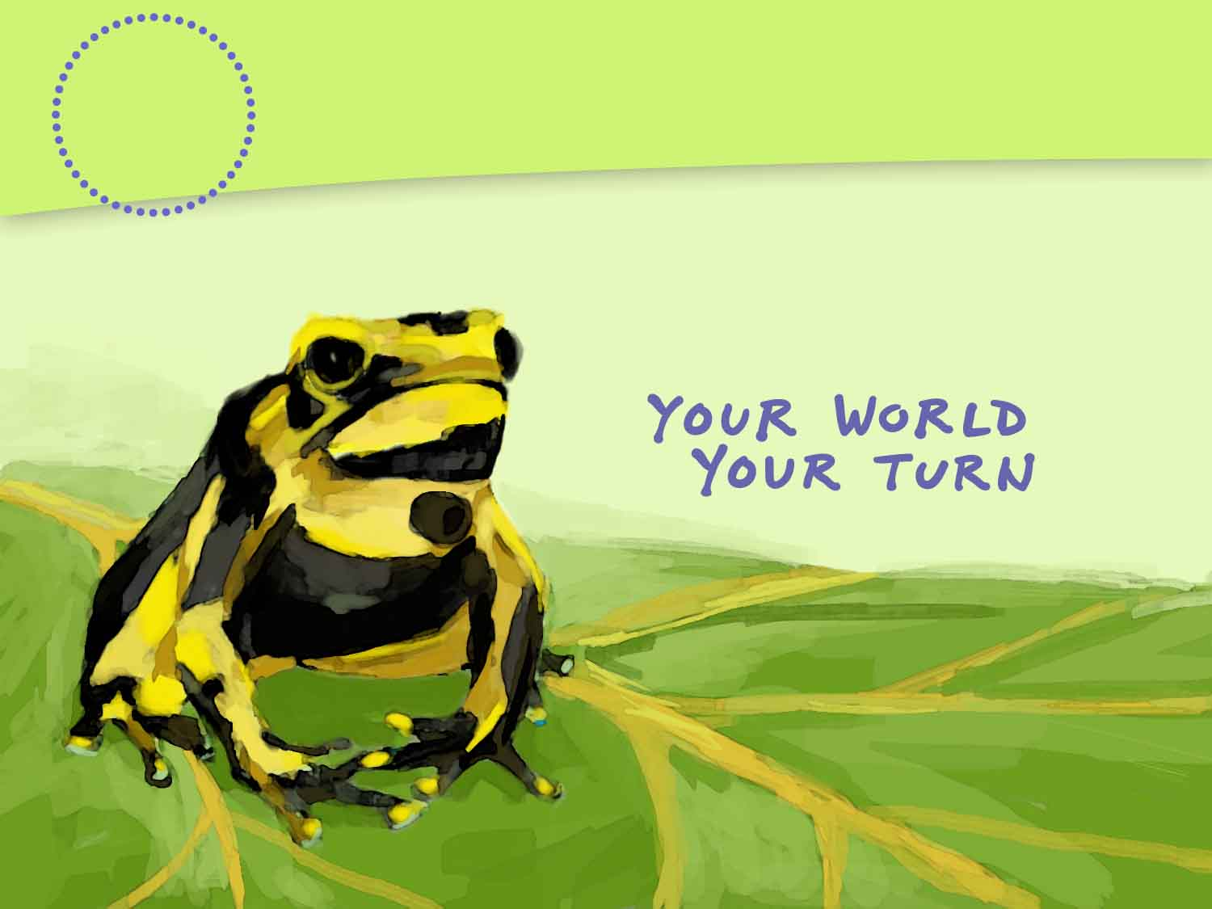
Population Ecology
4
CHAPTER
Notes:
Placeholder opening page, but maybe we can duplicate the look of the SE chapter opener page by using the same fonts and colors (and maybe that Ch 14 icon?)

Slide 2

Finding Gold in a Costa Rican Cloud Forest
Golden toads lived in Costa Rica’s Monteverde cloud forest.
Golden toads were first described in 1964. They were extinct by 1989.
Talk About It Why is the extinction of the golden toad a global concern?

Slide 3
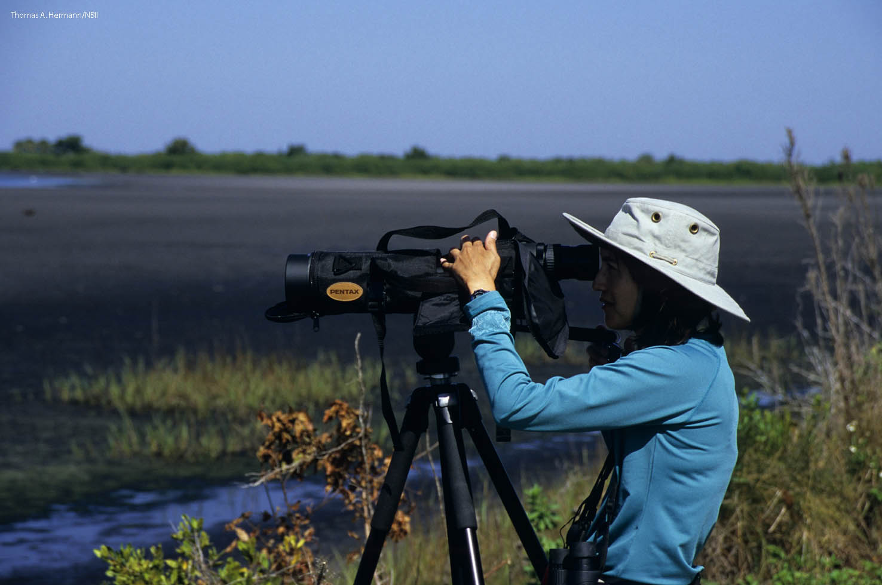
Lesson 4.1 Studying Ecology
Ernst Haeckel defined ecology in 1866 as “the body of knowledge concerning the economy of nature—the total relations of the animal to both its inorganic and organic environment.”

Slide 4
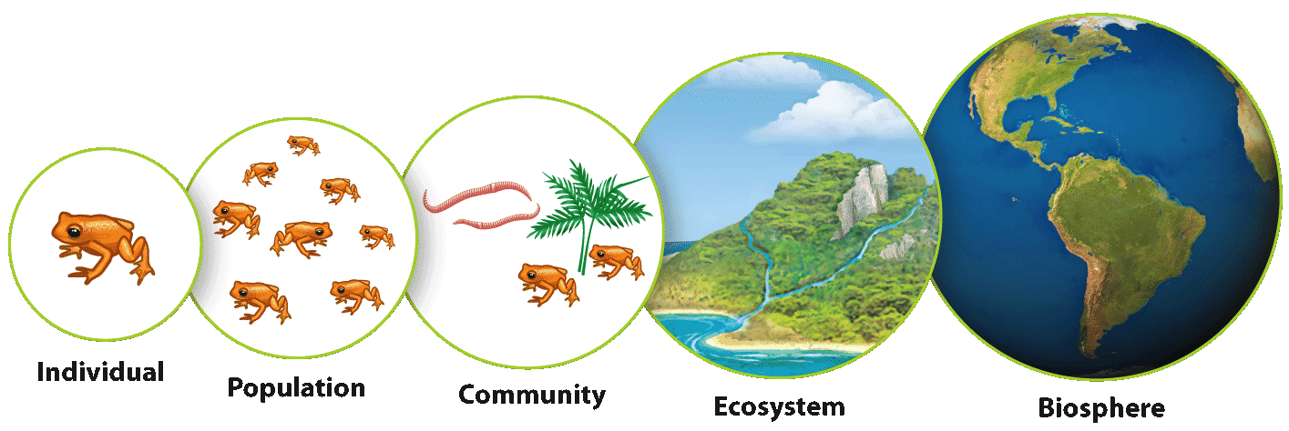
Levels of Ecological Organization
Lesson 4.1 Studying Ecology
The study of how organisms interact with each other and with their environments
Scientists study ecology at various levels of organization.

Slide 5
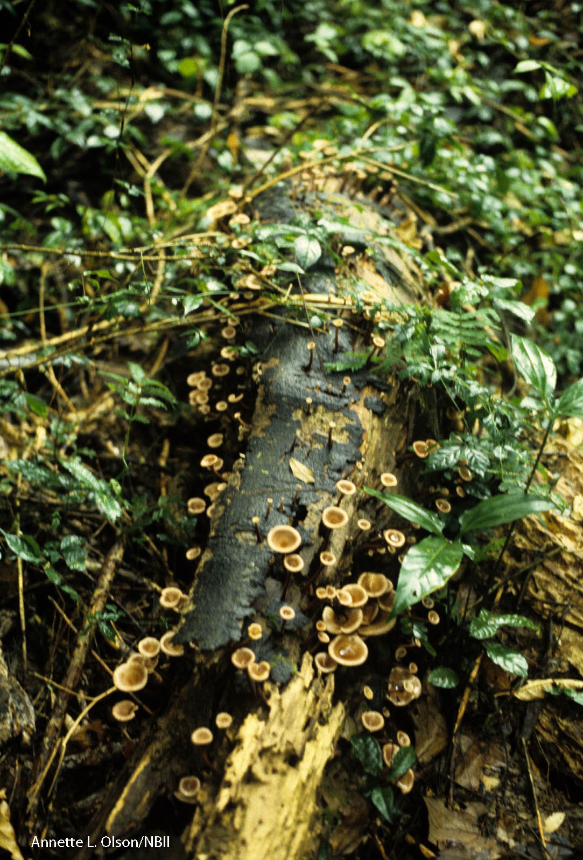
Biotic and Abiotic Factors
Lesson 4.1 Studying Ecology
Biotic factors: Parts of an ecosystem that are living or used to be living
Abiotic factors: Parts of an ecosystem that have never been living
Did You Know? Decaying organisms are biotic factors as long as their structure remains cellular.

Slide 6
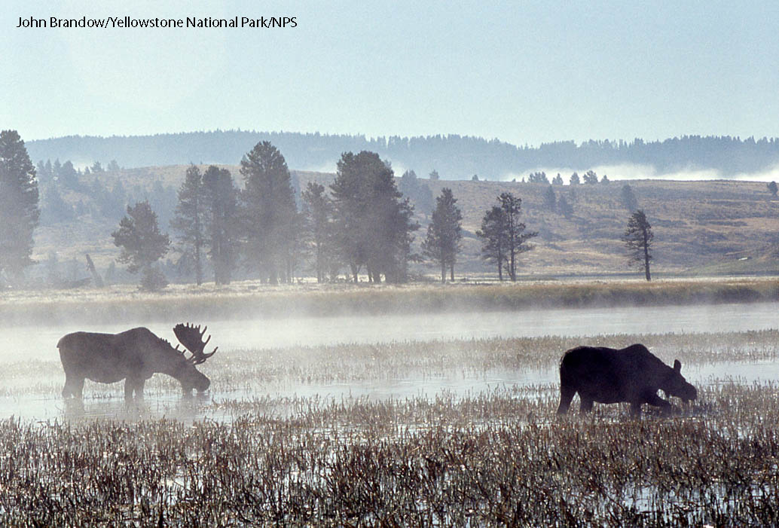
Habitat
Lesson 4.1 Studying Ecology
The specific environment in which an organism lives
Habitats provide an organism with resources—anything an organism needs to survive and reproduce, including food, shelter, and mates.

Slide 7
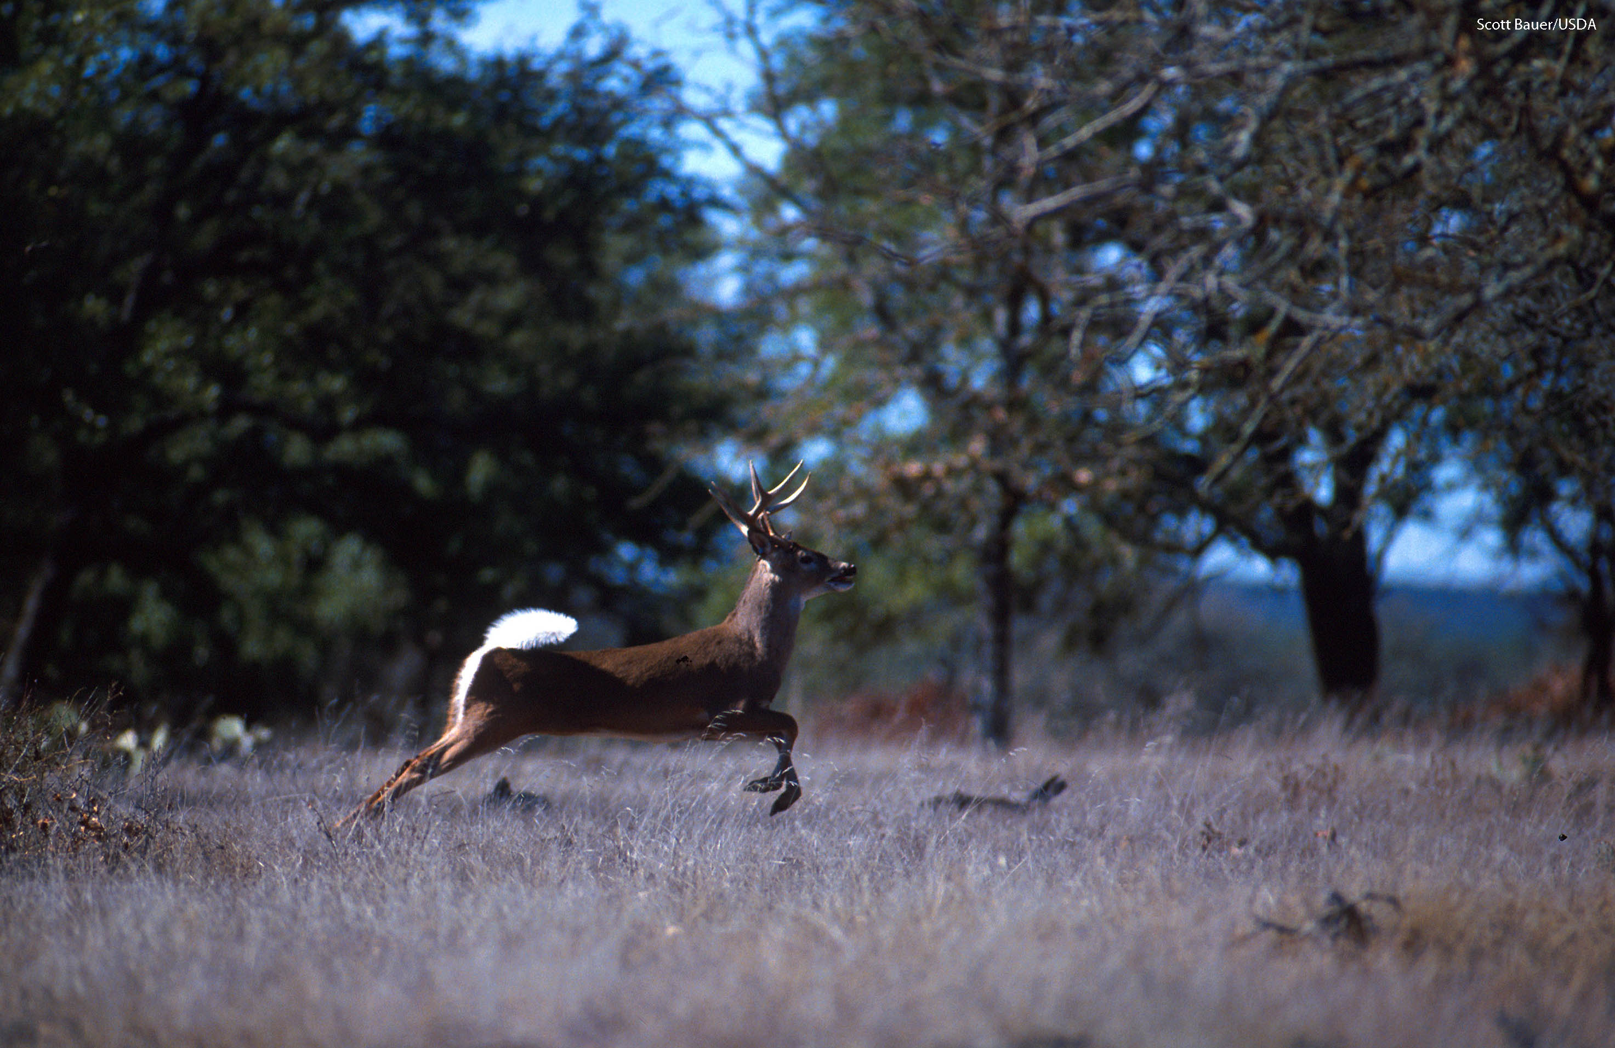
Lesson 4.2 Describing Populations
From 1900 to 2000, the white-tailed deer population of New York state grew from about 20,000 to more than 1 million. Densities of more than 100 deer per sq mi occur in some metropolitan areas.

Slide 8
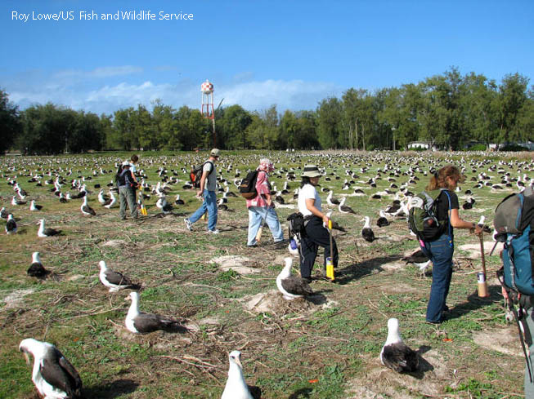
Population Size
Lesson 4.2 Describing Populations
The number of individuals in a population at a given time
Sudden and dramatic decreases in population size can indicate an unhealthy population headed toward extinction.
Ecologists often use sampling techniques to estimate population size.
Did You Know? The passenger pigeon was once North America’s most abundant bird. Hunting drove them to extinction in less than 100 years.
Counting Laysan Albatross Nests

Slide 9
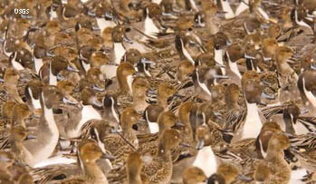
Population Density
Lesson 4.2 Describing Populations
Measure of how crowded a population is
Larger organisms
generally have lower
population densities.
Low population density:
More space, resources;
finding mates can be difficult
High population density:
Finding mates is easier; tends to be more competition; more infectious disease; more vulnerability to predators
Northern pintail ducks

Slide 10
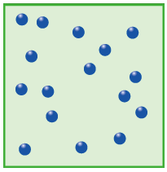
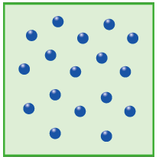
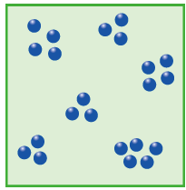
Population Distribution
Lesson 4.2 Describing Populations
How organisms are arranged within an area:
  Random distribution:
  Organisms arranged in
  no particular pattern
    Uniform distribution:
    Organisms evenly spaced
      Clumped distribution:
      Organisms grouped near resources; most common distribution in nature

Slide 11
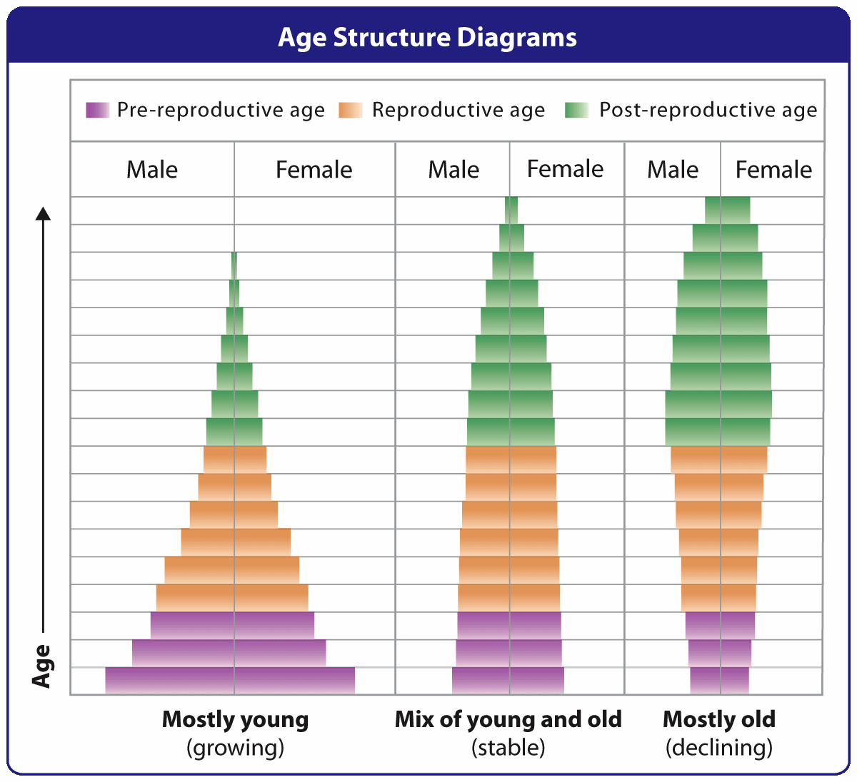
Age Structure
Lesson 4.2 Describing Populations
Relative number
of organisms of each age group within population
Can be used to predict future population growth of a population

Slide 12
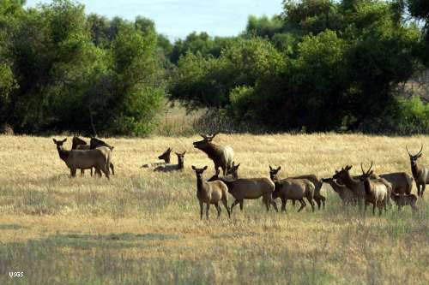
Sex Ratios
Lesson 4.2 Describing Populations
Proportion of males to females
Age structure diagrams give information about sex ratios.
For a monogamous species, the ideal sex ratio is 50:50.

Slide 13
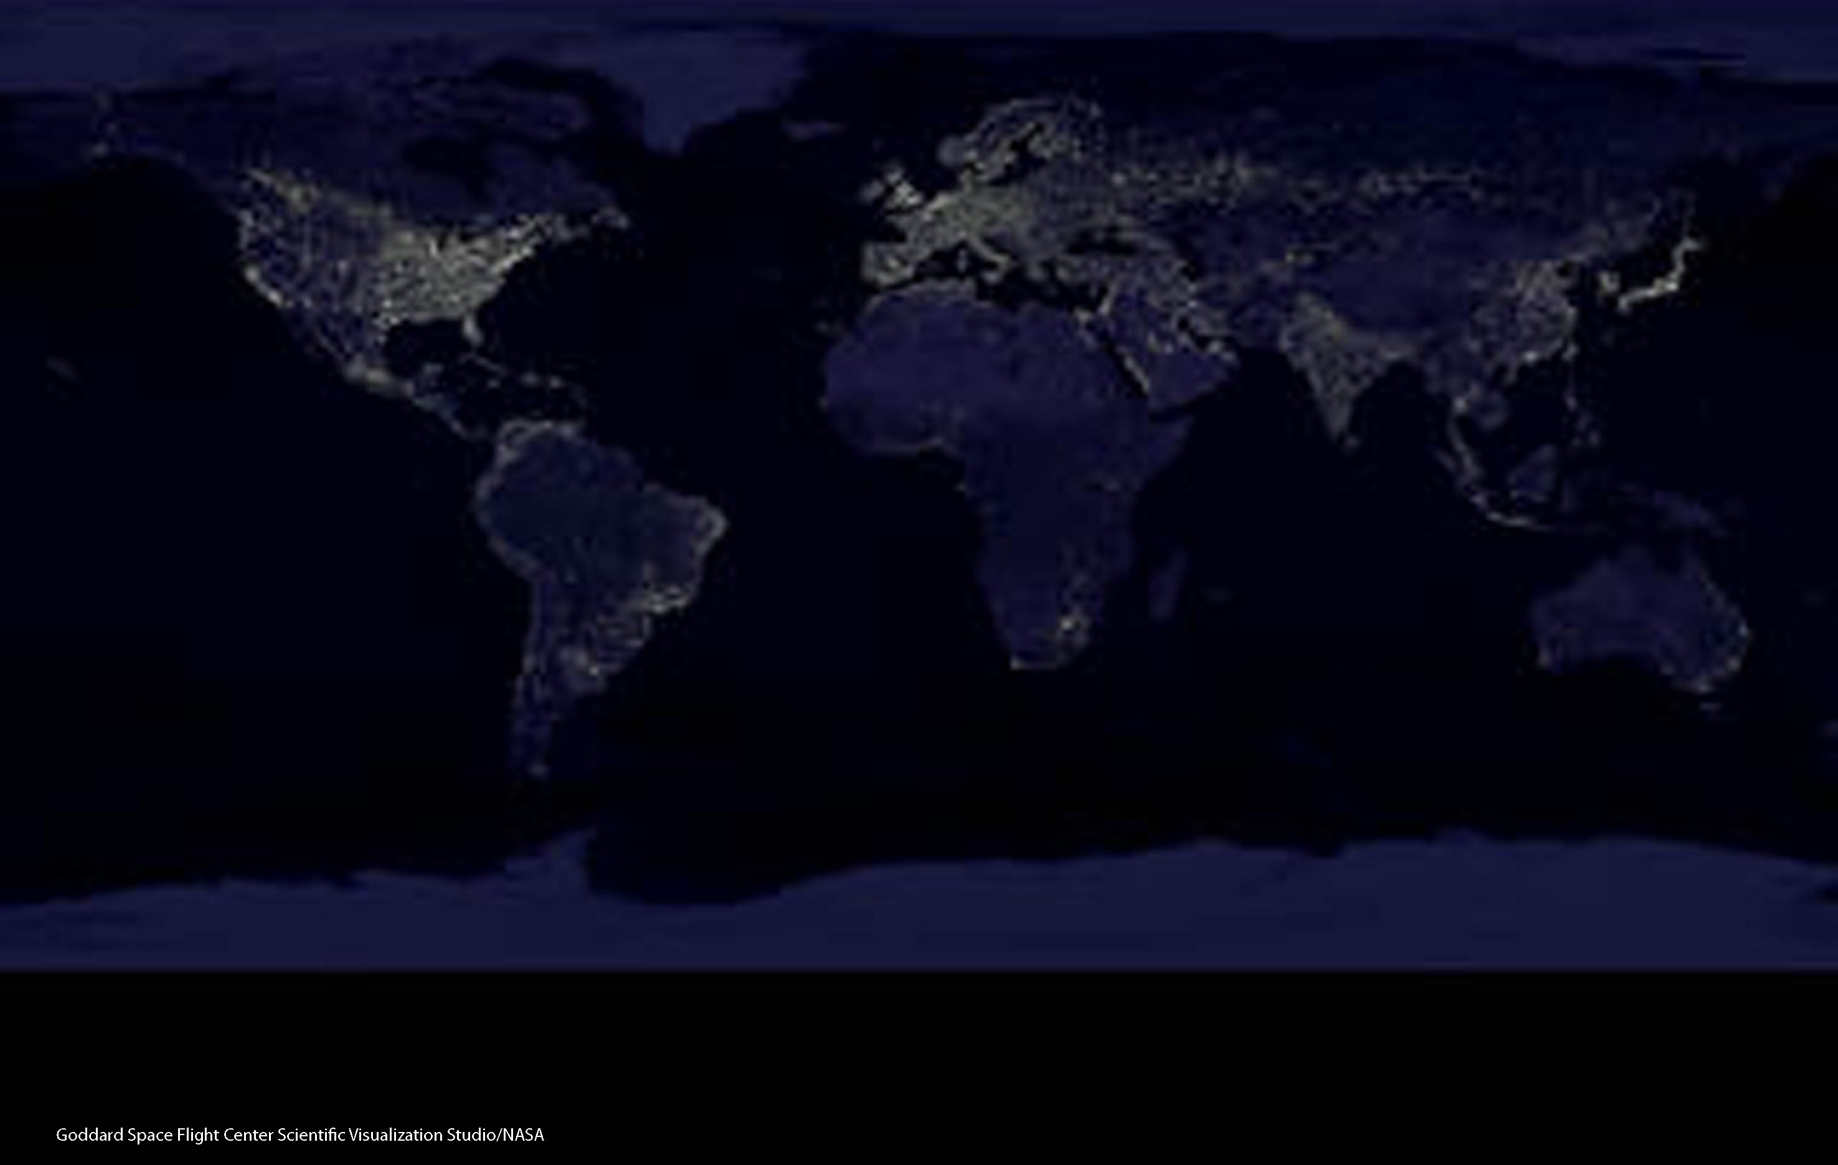
Lesson 4.3 Population Growth
From 1800 to today, the human population has grown from about
1 billion to more than 6.8 billion—an exponential rate of increase.

Slide 14
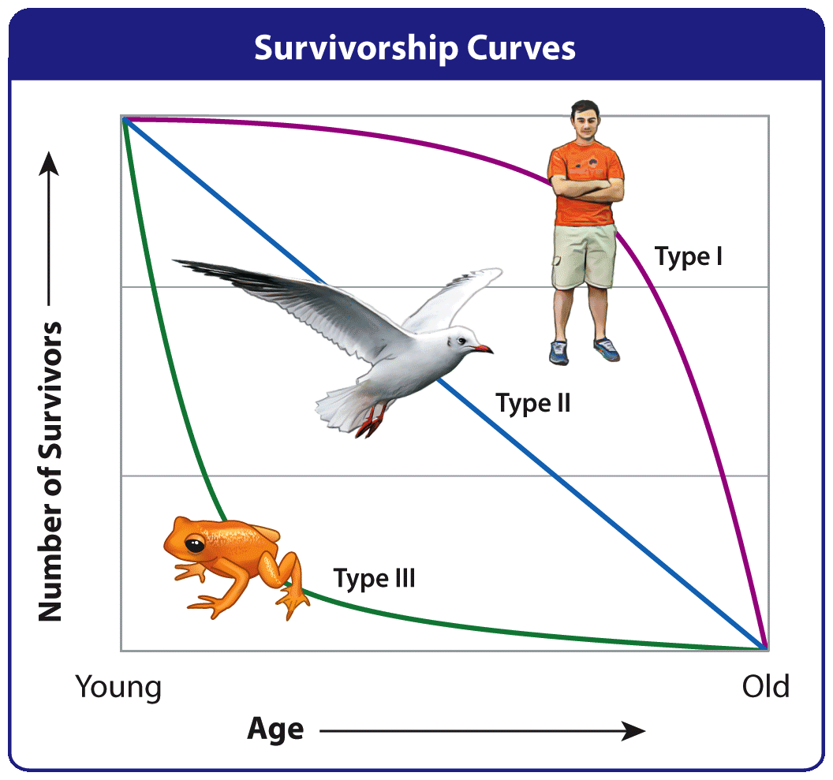
Birth and Death Rates
Lesson 4.3 Population Growth
A population’s relative birth and death rates (mortality and natality) affect how it grows.
Survivorship curves show how the likelihood of death varies with age.

Slide 15
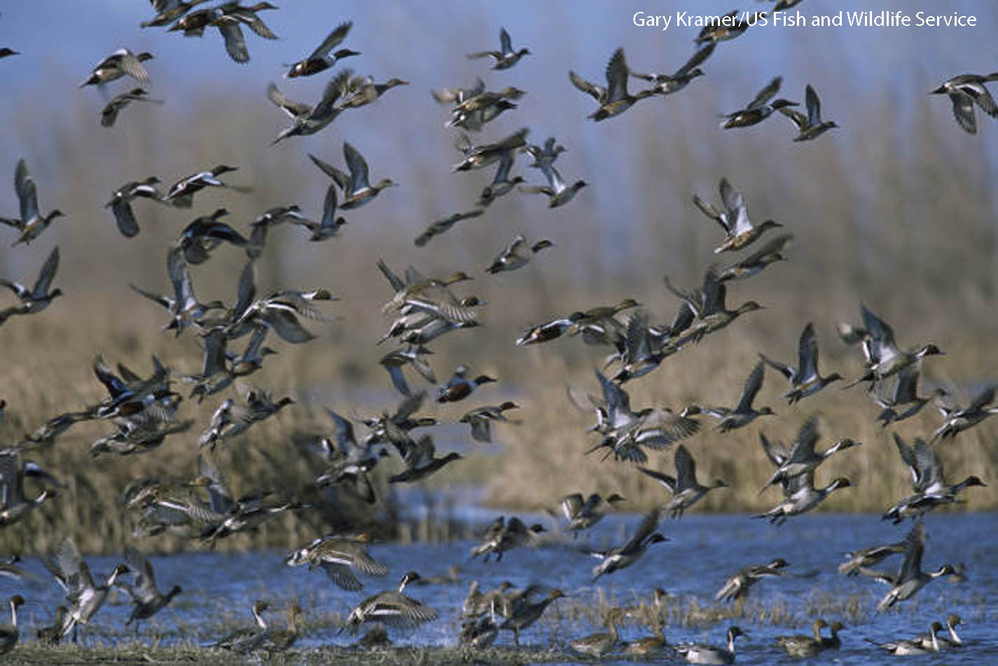
Immigration and Emigration
Lesson 4.3 Population Growth
In addition to births and deaths, population growth is affected by immigration and emigration—individuals moving into and out of a population.
Migration, seasonal movement into and out of an area,
can temporarily affect
population size.

Slide 16
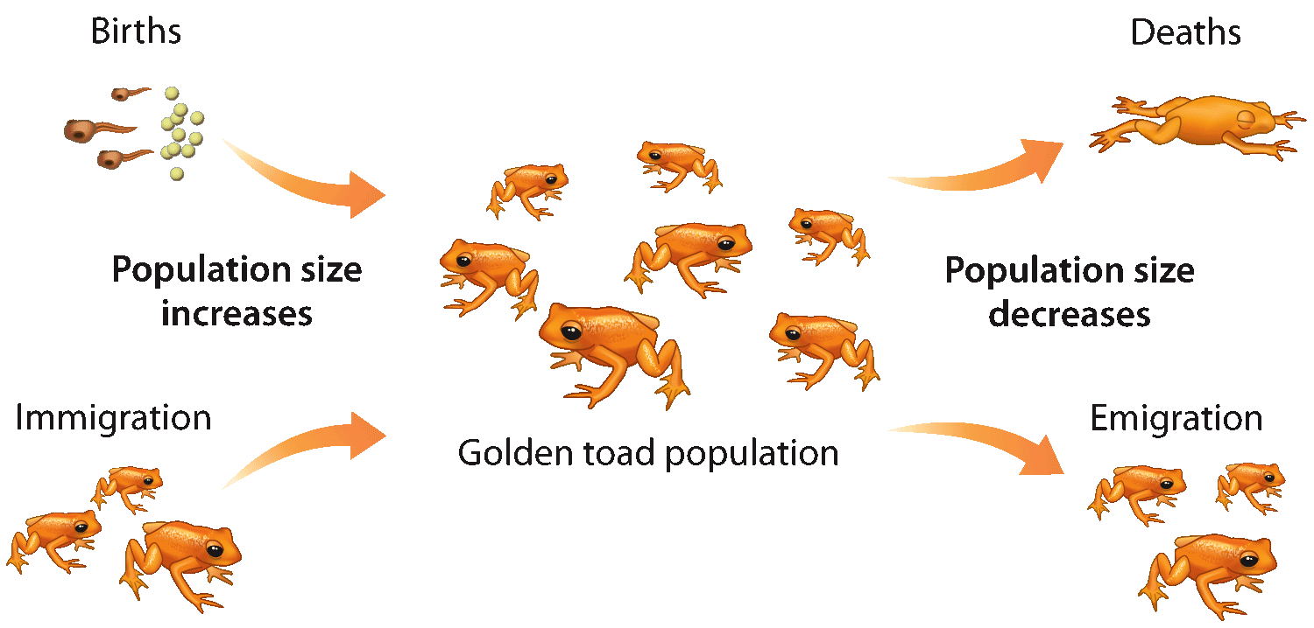
Calculating Population Growth
Lesson 4.3 Population Growth
Determined by the following equation:
(birthrate + immigration rate) – (death rate + emigration rate)
Growing populations have a positive growth rate; shrinking populations have a negative growth rate.
Usually expressed in terms of individuals per 1000
Did You Know? Immigration contributes more than 1 million people to the U.S. population
per year.

Slide 17
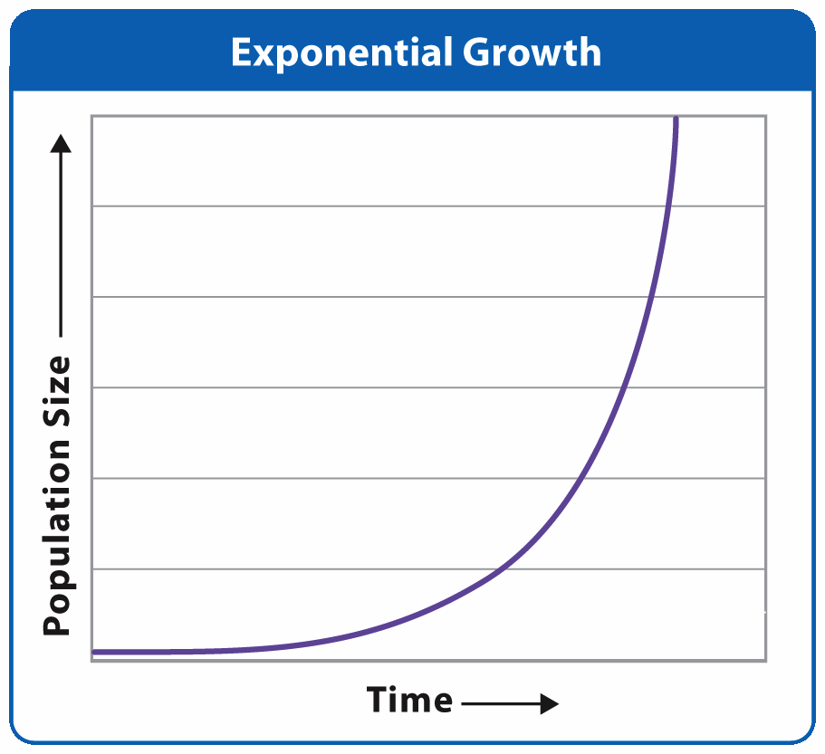
Exponential Growth
Lesson 4.3 Population Growth
Population increases by
a fixed percentage
every year.
Normally occurs only when small populations are introduced to an
area with ideal environmental conditions
Rarely lasts long

Slide 18
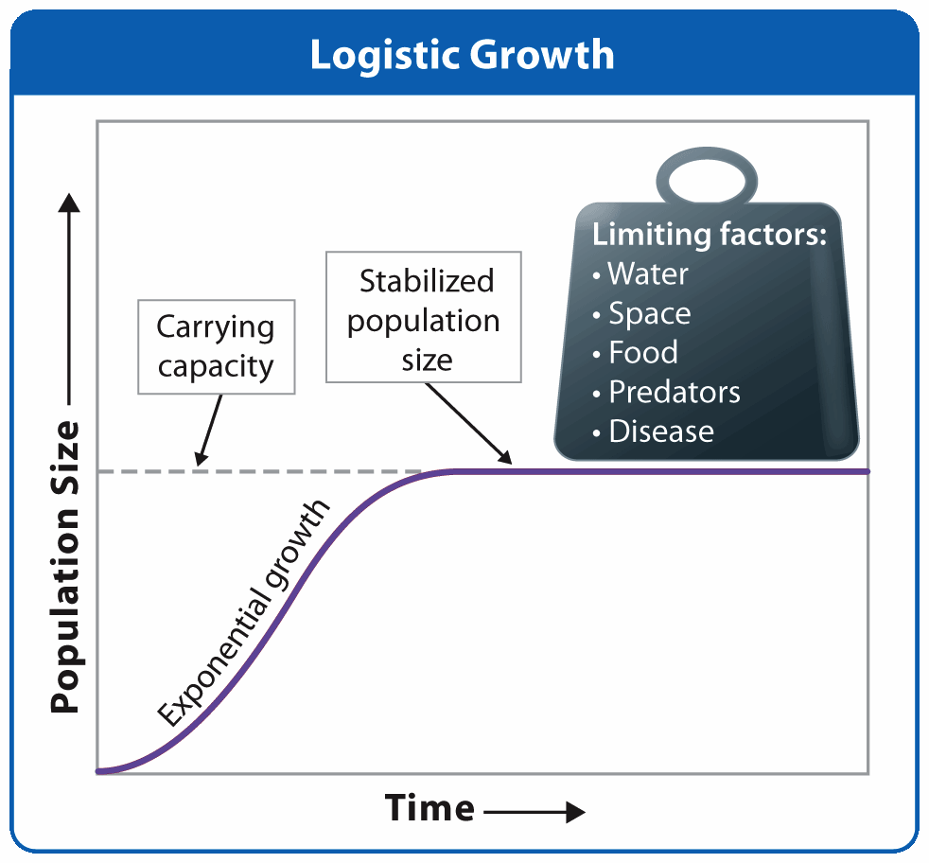
Logistic Growth and Limiting Factors
Lesson 4.3 Population Growth
Growth almost always slows and
stops due to limiting factors.
Limiting factors:
Environmental
characteristics
slow population growth
and determine carrying
capacity.
  Density-dependent:
  Influence changes with
  population density.
  Density-independent:
  Influence does not change with population density.

Slide 19
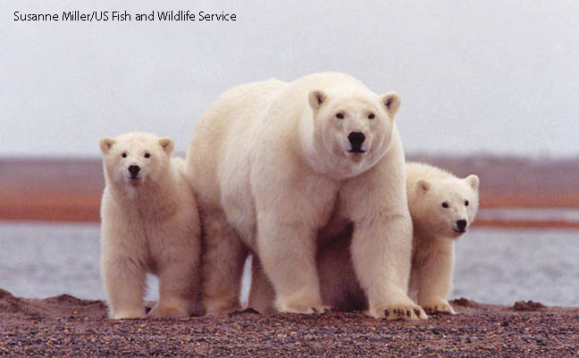
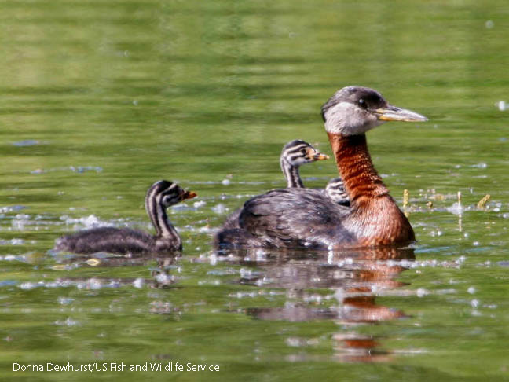
Biotic Potential
Lesson 4.3 Population Growth
An organism’s maximum ability
to produce offspring in ideal conditions
Many factors influence biotic potential, including gestation
time and generation time.
Organisms with high biotic potential can recover more
quickly from population declines than organisms with low biotic potential.

